Slide 1
Evidence of
6.0 Instructional Resources
Council on Accreditation of Parks, Recreation, Tourism and Related Professions (COAPRT)
Longwood University
Farmville, Virginia

Slide 2
6.02
There shall be properly located and equipped faculty offices of sufficient quality to adequately address privacy and confidentiality issues, and that are of a number and size comparable to other programs housed in the academic unit and consistent with institutional policy.
Each TR faculty member has a private office equipped with two desks, a desktop computer, printer, scanner, two bookshelves, a locked file cabinet and approximately 3-4 chairs. Offices and file cabinets have locks to secure confidential material.
TR faculty offices are located in Willett Hall. The offices are approximately 11 x 12 feet.
Photos on next slide

Slide 3
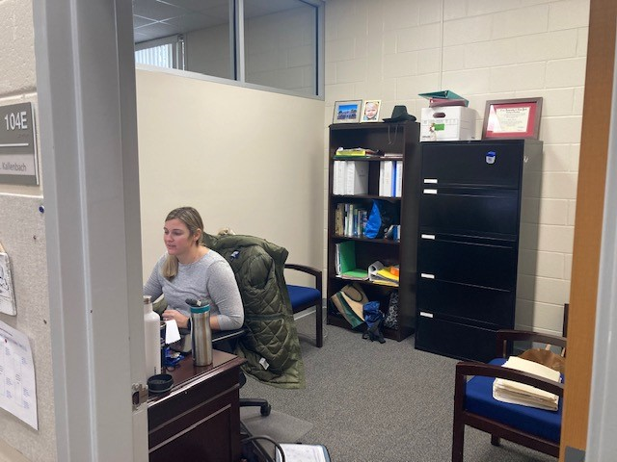
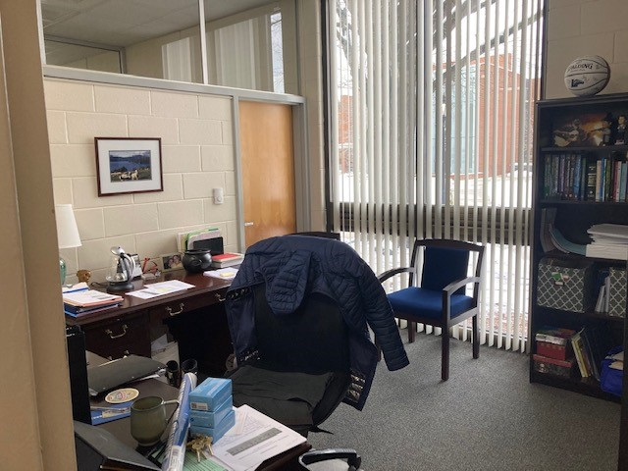
TR Faculty Offices
(Whitney Kallenbach & Ann Bailey)

Slide 4
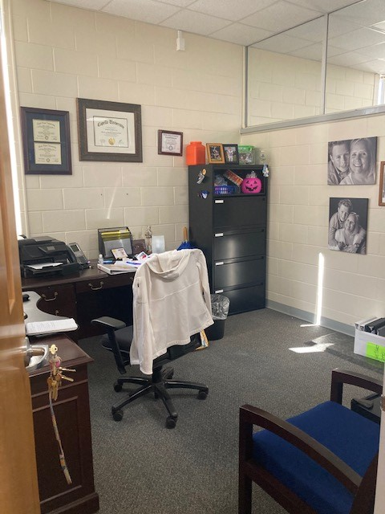
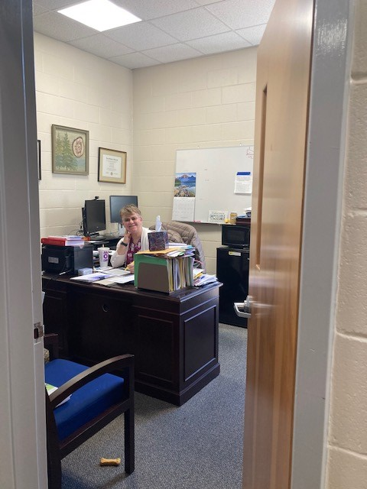
TR Faculty Offices
(Susan Lynch & Kirstin Whitely)

Slide 5
6.03
There shall be adequate conference rooms for faculty use, study areas for students, and meeting space for student organizations.
Classroom 104 C in Willett Hall is a multi-purpose room and is used as the department conference room. The tables and chairs can easily be configured into large and small conference style settings. Faculty also use this space to meet with students.
Laboratory and classroom 117 in Willett Hall is the designated therapeutic recreation lab space. TR faculty and the TR student organization meet in this space. TR Faculty also use this space to meet with students.
Ample study spaces and meetings spaces for student organizations are located throughout the newly built Upchurch Student Union on campus.
Photos on next slide

Slide 6
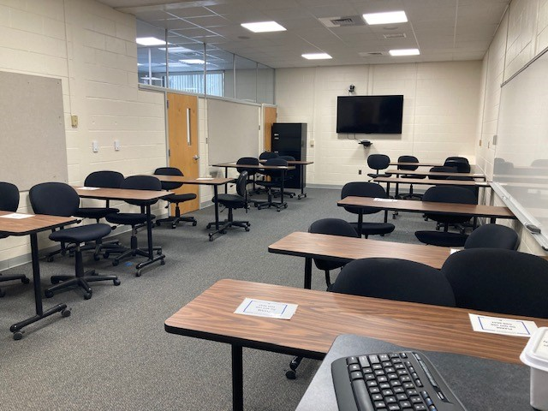
Room 104 C in Willett Hall
Multi-purpose meeting space and conference room

Slide 7
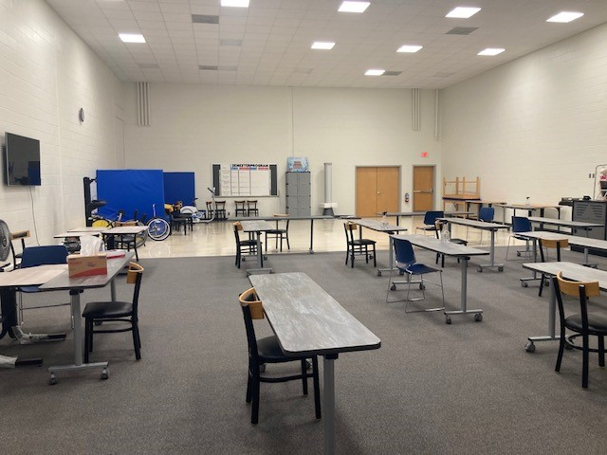
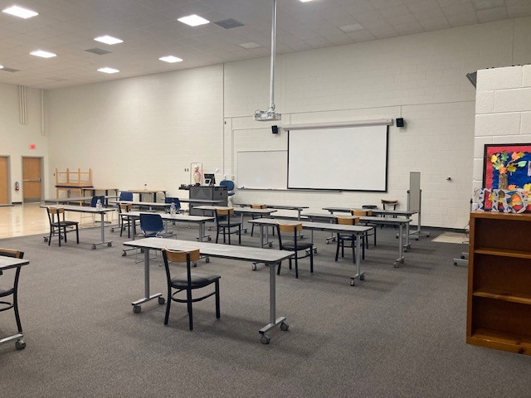
Room 117 in Willett Hall
Designated TR Laboratory and Classroom Space – also used for faculty and students to meet

Slide 8
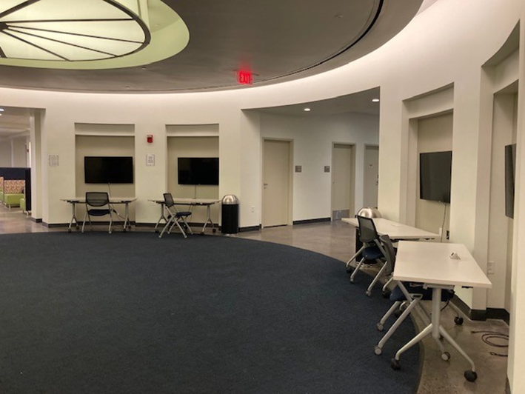
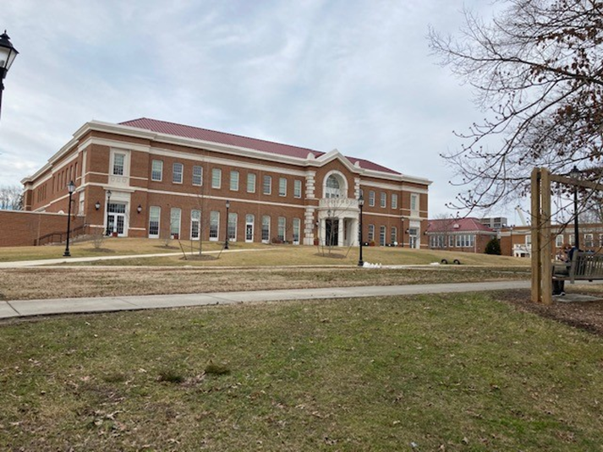
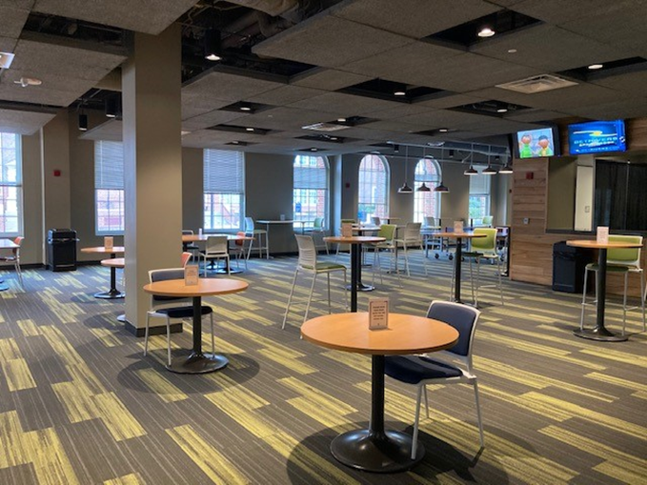
Student Union (study and meeting spaces)

Slide 9
6.04
There shall be classrooms, laboratory and teaching areas, and appropriate content specific instructional areas for the academic unit.
Room 117 in Willett Hall is the designated therapeutic recreation classroom and laboratory space. Most of the TR classes are held in this room.
Additional spaces used for classroom and skill instruction include Willett 101 (gymnasium) and Willett 118 (dance studio).
Willett Hall houses three more classrooms that can be utilized by the TR faculty. Willett 111 is pictured to show an example.

Slide 10


Willett Room 117 (TR Classroom & Lab Space)

Slide 11
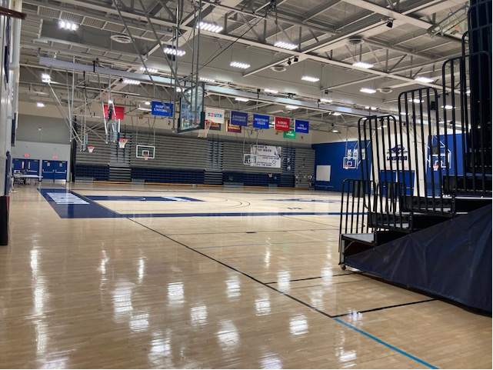
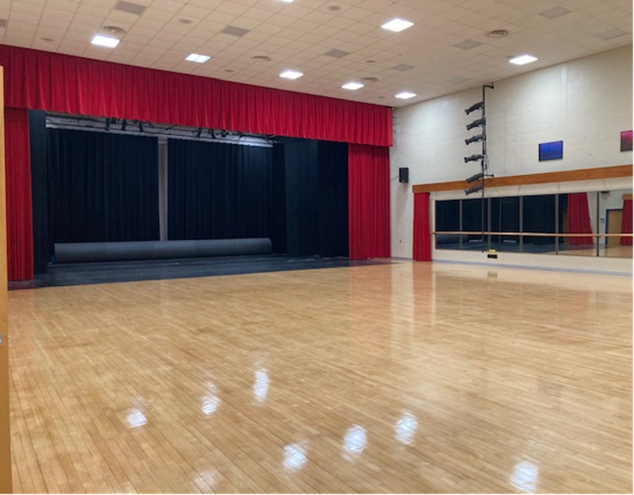
Willett Rooms 101 & Willett 118

Slide 12
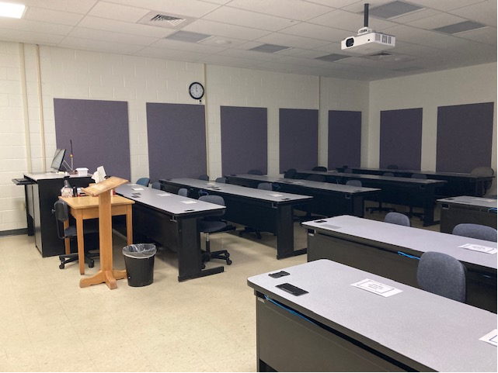
Willett Room 111 (general classroom)

Slide 13
6.06
All instructional areas, faculty offices, and other educational facilities shall comply with the requirements of the Americans with Disabilities Act (ADA) and the amendments to the Act.
Willett Hall has supplied automatic door openers on both the front and back entrances (inside and outside of doors).
Willett Hall also has a ramp leading into the main portion of the building which houses the teaching spaces and faculty offices.
A ramp is also located at the back entrance of Willett hall.
Faculty offices and classroom spaces are wheelchair accessible.

Slide 14
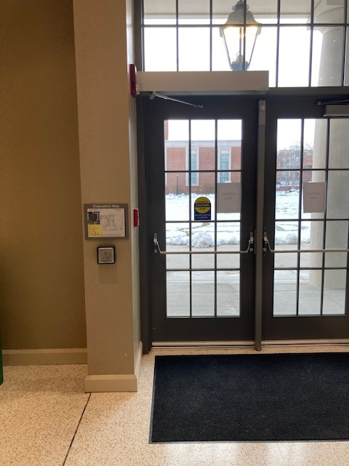
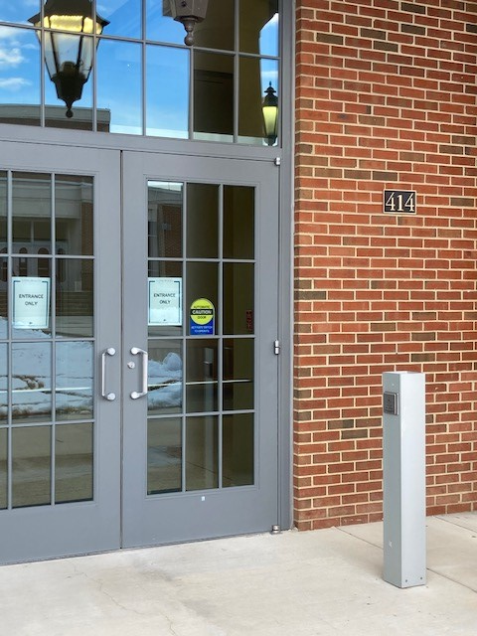
Automatic Door Openers on Willett Hall Front entrance

Slide 15
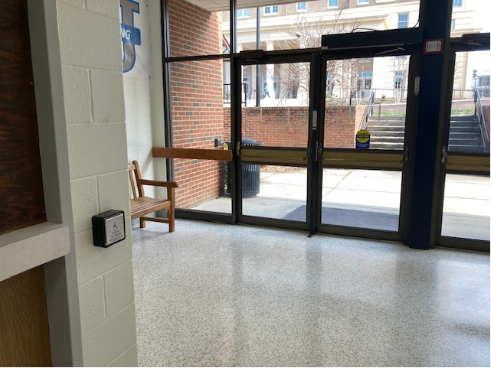
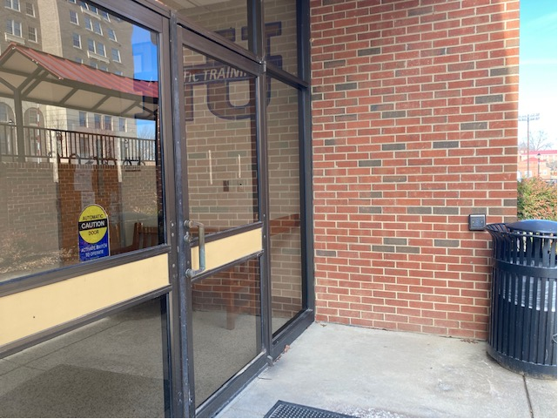
Automatic Door Openers on Back Entrance of Willett Hall

Slide 16
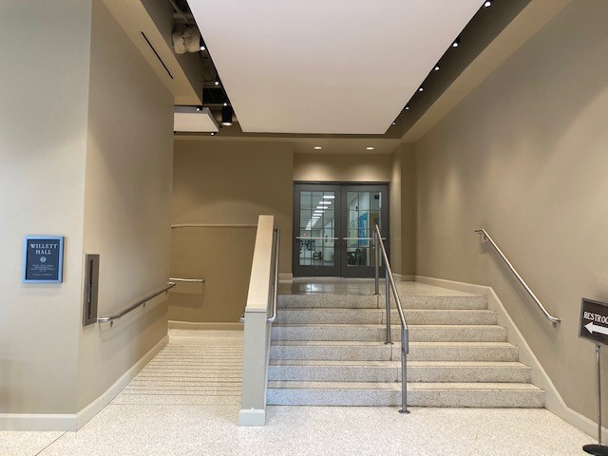
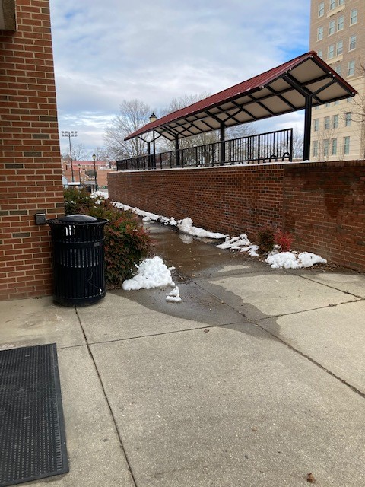
Ramps leading into front and back entrance of building

Slide 17
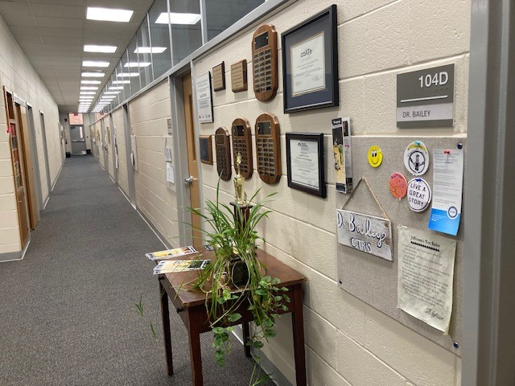
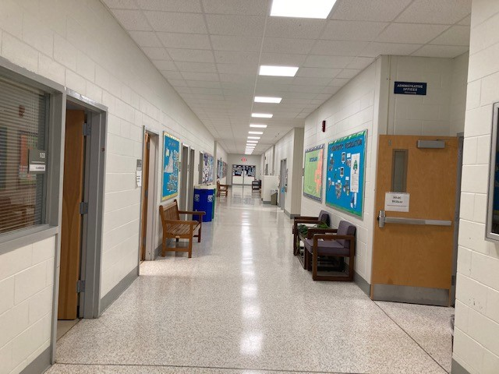
Hallways in Willett Hall
Hallway leading to classrooms
Hallway leading to faculty offices

Slide 18
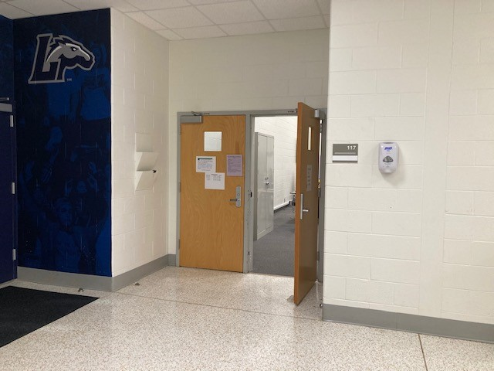
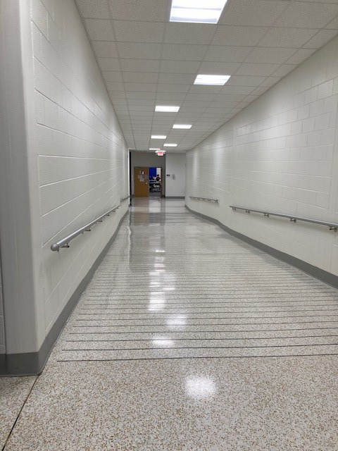
Hallway & Ramp leading to TR Lab & Classroom space
Entrance to Willett 117 (TR Lab & Classroom)

Slide 19
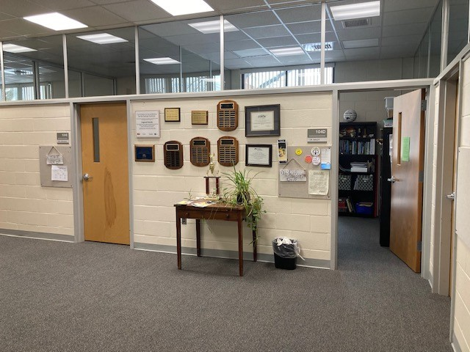
Doorways leading to faculty offices

